Slide 1
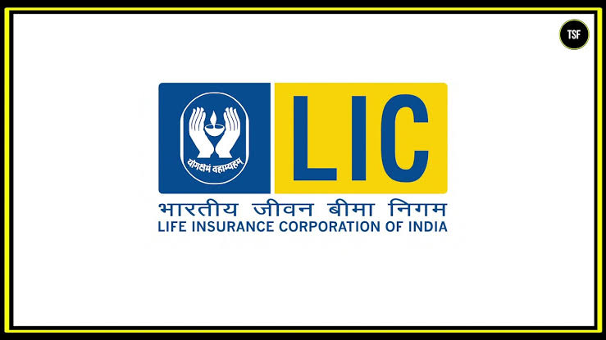

Team Leader : KOYYANA SNEHA
Team Members : LOKANADHAM KAVYA
LINGALA KUSUMA KUMARI
LOCHARLA SHYAMALA
MUDDADA LALITHA

Slide 2
COMPREHENSIVE DIGITAL MARKETING FOR LIFE INSURANCE CORPORATION (LIC)

Slide 3
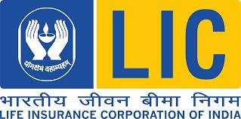
INTRODUCTION
BRANDING “ LIFE INSURANCE OF CORPORATION ”
ANALYSING OF BRAND MESSAGING
SMART GOALS OF LIC
KPI‘s OF LIC
COMPITATOR ANALYSIS
BUYERS / AUDIENCE PERSONA
SEO and KEYWORD RESEARCH
CONTENT IDEAS and MARKETING STRATEGIES
CONTENT CREATION and CURATION
INSTAGRAM STORY

Slide 4
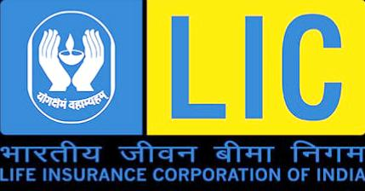
LIFE INSURANCE CORPORATION
INTRODUCTION :
Life Insurance Corporation of India is an Indian multinational public sector life insurance company headquartered in Mumbai. It is India's largest insurance company as well as the largest institutional investor with total assets under management worth ₹45.7 trillion as of March 2023.

Slide 5
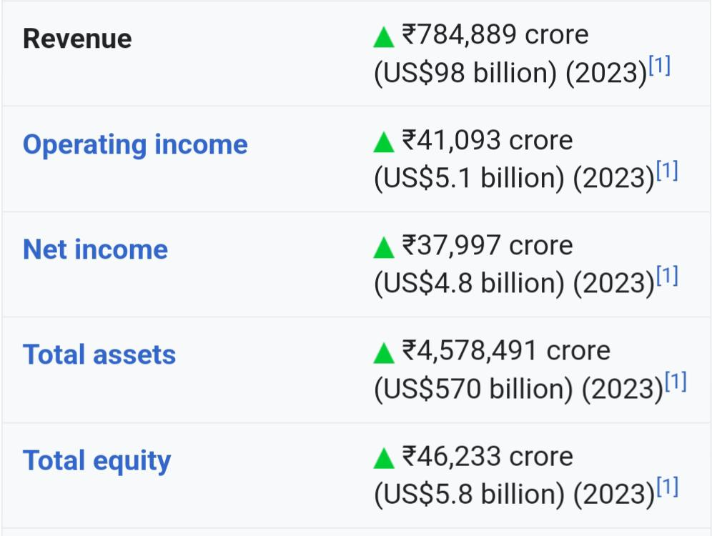
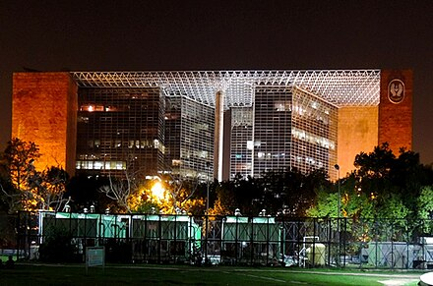
LIC, NEW DELHI.

Slide 6
Brand study, Competitors Analysis and Buyer’s/Audiences Persona.
Research of Brand Identity
Mission/ Values :- Ensure and enhance the quality of life of people through financial security by providing products and services of aspired attributes with competitive returns, and by rendering resources for economic development.
USP :- LIC thus concentrates on mass volumes as a unique selling proposition. Unlike private players, the company claims it has fewer delinquencies, lapsed policies and discontinuance of high premium policies, a claim that many contest.

Slide 7
Analyzing of Brand messaging
Tagline : Yogakshemam Vahamyaham
Logo : LIC Logo is made up of a flame that signifies life and the protective hands of life insurance that ensure its continuance.
Innovation : The impact of this innovation was felt more on the private sector business, as LIC with its penchant for traditional business and its dominant market presence, neutralized the distribution between traditional plans and ULIPs to a great extent. In fact, for many of the private players, the share of ULIPs was above 80% of their total new business.
Values : Life Insurance Corporation, India's leading insurance company, had a brand value worth 9.8 billion U.S. dollars, putting the company on the third spot of the top 100 most valuable Indian brands.
Digital transformation : Besides customer onboarding we have undertaken a project for total digital transformation. All our operations will be carried out in digital mode. Once this project takes off, over 95% work will be done through the digital mode.

Slide 8
Smart Goals of LIC
Conduct business with utmost economy and with the full realization that the moneys belong to the policyholders.
Act as trustees of the insured public in their individual and collective capacities.
Meet the various life insurance needs of the community that would arise in the changing social and economic environment.

Slide 9
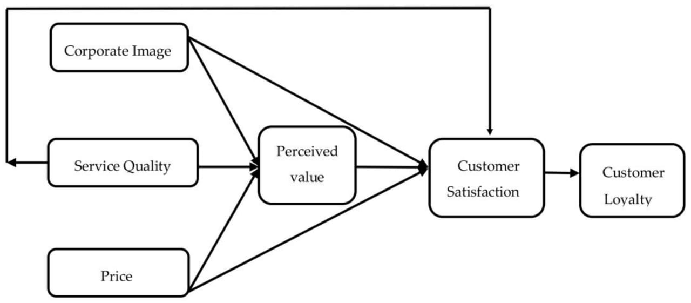
KPIs of LIC
Revenue growth : Life Insurance Corp of India (LIC) recorded a 14-fold year-on-year jump in net profit at ₹9,543.7 crore for the first quarter of FY24, even though the country's largest insurer has been witnessing a shrink in its market share in terms of new business premium.
Client Satisfaction :
Above chart showing satisfaction level of customers is 92%and people who not satisfied with services of LIC is 8%.

Slide 10
Environmental & Social responsibility : Improving access to water by funding irrigation and water storage structures, Promoting public transport by creating appropriate infrastructure, Improving watershed development and afforestation Preservation and protection of flora and fauna Conversation and maintaining quality of natural resources.

Slide 11
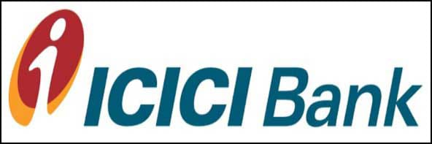
Competitors Analysis
Compitators to LIC
COMPETITOR 1: ICICI BANK
USP : ICICI is the most efficient and tech savvy bank in the indian banking industry
Online Communication : Improving access to water by funding irrigation and water storage structures, Promoting public transport by creating appropriate infrastructure, Improving watershed development and afforestation Preservation and protection of flora and fauna Conversation and maintaining quality of natural resources.
Swat Analysis :
Strength : ICICI's total assets are Rs. 4062.34 billion and reported a cumulative after-tax income of Rs. 51.51 billion, in 19 countries. According to financial analysts, one of the major strengths of ICICI bank is its solid and consistent balance sheet and financial statements. .

Slide 12
Weaknesses : Customer service for the ICICI segment is not doing well when it comes to complaining resolution.
Opportunities : In rural areas, the idea of saving in banks and investing in financial products is growing, as more than 62 percent of India’s population is still in rural areas.ICICI Bank plans to open 1500 new branches over the next four years.Because of its financial resources, ICICI will buy small and non-performing banks.
Threats : HDFC is ICICI's biggest rival, and other emerging banks such as AXIS, HSBC place a significant threat. NBFC and Mobile Payment Wallets are also emerging and become competitors of ICICI Bank. The micro-financing groups have a large share in rural areas.

Slide 13
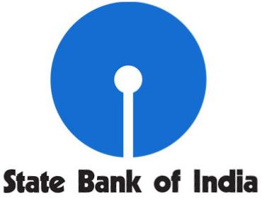
COMPETITOR 2 : STATE BANK OF INDIA
USP : State Bank Of India (SBI) is bank which every India can trust
Online Communication : SBI's internet banking portal provides personal banking services that gives you complete control over all your banking demands online. CORPORATE BANKING. yono BUSINESS. yono BUSINESS.
Swat Analysis :
Strength : SBI is India's biggest bank in terms of market share, sales, and reserves.SBI has been ranked in the Fortune Global 500 list.According to recent reports, the bank has more than 22141 branches and 58555 ATM's.
Weaknesses : The lack of adequate technology-driven infrastructure relative to private banksEmployees are hesitant to fix issues efficiently due to better job stability, and the turnaround period for clients is lengthy relative to private banks.The banks pay a large sum on their leased houses.
Opportunities : The merger of SBI with five other banks, namely the State Bank of Hyderabad, the State Bank of Patiala, the State Bank of Bikaner and Jaipur, the State Bank of Travancore and the State Bank of Mysore, is at the approval stage.
Threats : Customers prefer to switch to private banks and financial service providers for loans and mortgages, as SBI involves strict verification procedures and takes a long time to process.

Slide 14

COMPETITOR 3 : AXIS BANK
USP : Axis Bank is its commitment to providing a wide range of financial products and services to meet the diverse needs of its customers.
Online Communication : you can always reach out to Axis Bank Support at 1860-419-5555/1860-500-5555 for and get WhatsApp Banking services blocked on your device.
Swat Analysis :
Strength : Axis Bank was ranked is the fastest growing Bank in the Private Sector. Financial Express and KPMG have rated Axis Bank as the best bank on the basis of 26 parameters.Axis Bank has 4800 regional branches and 17801 ATMs.
Weaknesses : AXIS bank’s share prices are continually fluctuating at higher margins, leaving investors in an awkward position most of the time.There are a lot of efficiency differences in the financial product as well as reaching out to the consumer.
Opportunities : The rural market is also a major market for Axis Bank.Acquisitions for filling the void. Various future prospects in financial markets, such as mutual funds, maybe exploited in the Bond Market.
Threats : RBI control of interest rates.Regulation of the State on the basis of pandemic circumstances.Foreign Investments in Banking Sector.

Slide 15
Buyer’s / Audience Persona
A buyer persona is a detailed description of someone who represents your target audience. This persona is fictional but based on deep research of your existing or desired audience. You might also hear it called a customer persona, audience persona, or marketing persona.
LIC mainly targets children who are basically into schooling, people in earning periods and senior citizens who have got retired from their respective services. It not only targets the urban people but also the rural people.

Slide 16
SEO and KEYWORD RESEARCH
Website Traffic : Website ranking helps evaluate the value of a business. Over the last three months, licindia.in's global ranking has decreased from 2,897 to 2,632.
Back Link analysis : In September the number of backlinks to licindia.in has dropped by 98% and equals 3.3m, the amount of refering domines has increased by 88% and equals 17k
Mobile friendly : licindia. In is a mobile friendly
Duplicates : There is no duplicates for licindia.in
No malware found in the website
0 pages were blocked by robots.text
No pages have content with low word count
No pages without headers are ddetected.
Found 5 page redirects
KEYWORD RESEARCH :
Keyword for Lic – there are many keyworda for lic . For example :- lic, lic of india, liclogin, www.licindia.in etc

Slide 17
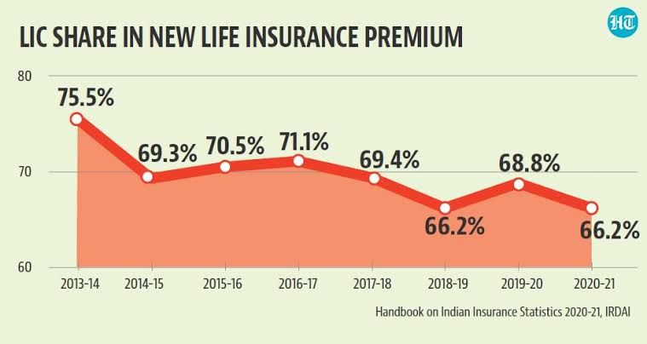
On page optimization :
Life insurance is a contract that pledges payment of an amount to the person assured (or his nominee) on the happening of the event insured against.
Unfortunate death, if it occurs earlier. Among other things, the contract also provides for the payment of premium periodically to the Corporation by the policyholder.
Life Insurance Corporation, India's leading insurance company, had a brand value worth 9.8 billion U.S. dollars, putting the company on the third spot of the top 100 most valuable Indian brands.
The main slogan of LIC is- “Yogakshemam Vahamyaham” meaning “Your welfare is our responsibility”.

Slide 18
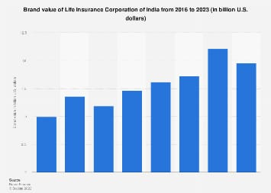
Ex :- Graph with the strategy, aim and idea of each content piece
According to this valuation, LIC is largest and strongest brand in the country with a valuation of USD 8.655 billion in 2021, which grew by 6.8

Slide 19
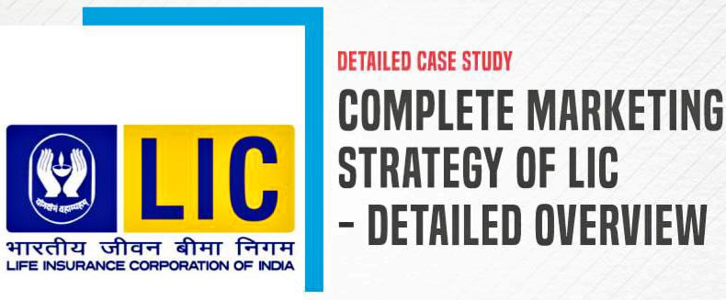
Content ideas and Marketing strategies
The motive of using a marketing strategy is to achieve business goals & objectives. There are several strategies like product/service innovation, marketing investment that has helped the brand grow. Let’s take a look at the marketing strategies used by LIC
LIC offers a variety of products differing from other insurance companies, which helped them to stand out from the rest of the companies.
It got the first-mover advantage.
With the help of advertisements, LIC promotes its brand value.
They use creative slogans to attract the customer’s mindset.
They avoid any unnecessary interference with the customers so that the correct messages can be reached to all of their customers.

Slide 20
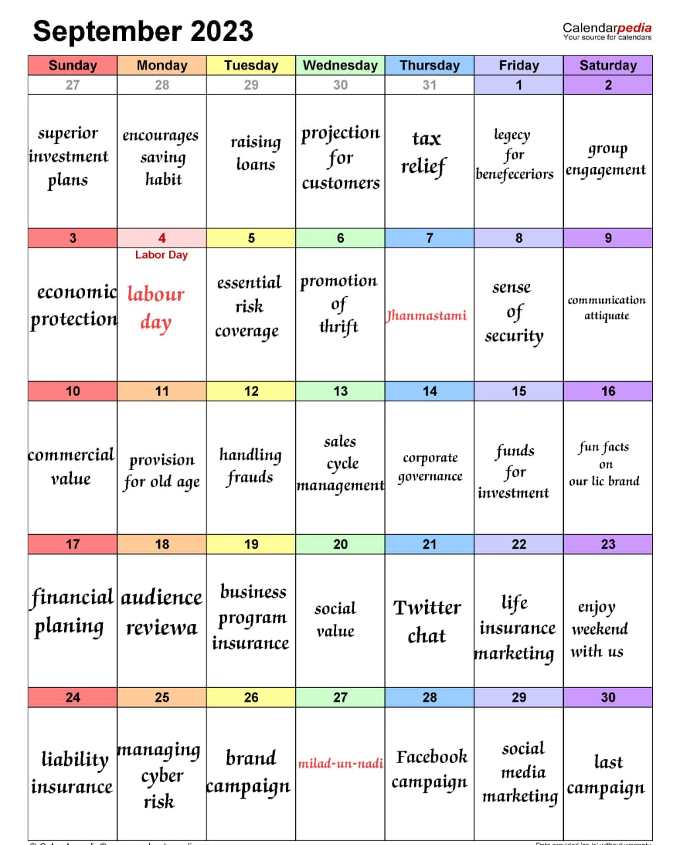
Content ideas and Marketing strategies
LIC
CONTENT CALENDAR

Slide 21
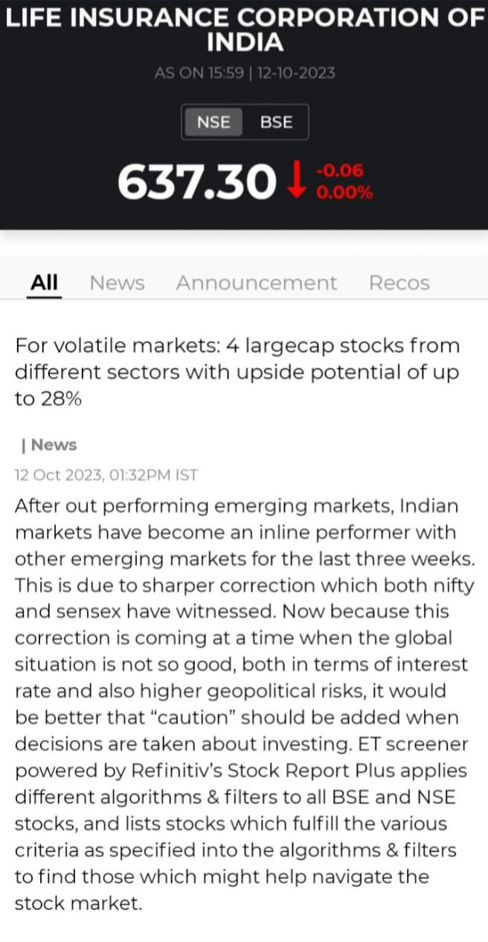
Content creation and Curation
Post creation :
Formate 1 : Article
For volatile markets: 4 largecap stocks from different sectors with upside potential of up to 28% In Lic.
Caption along with CTA’s
Sometimes it’s not about lending money, but giving a helping hand.
Contact us : 8901801001

Slide 22
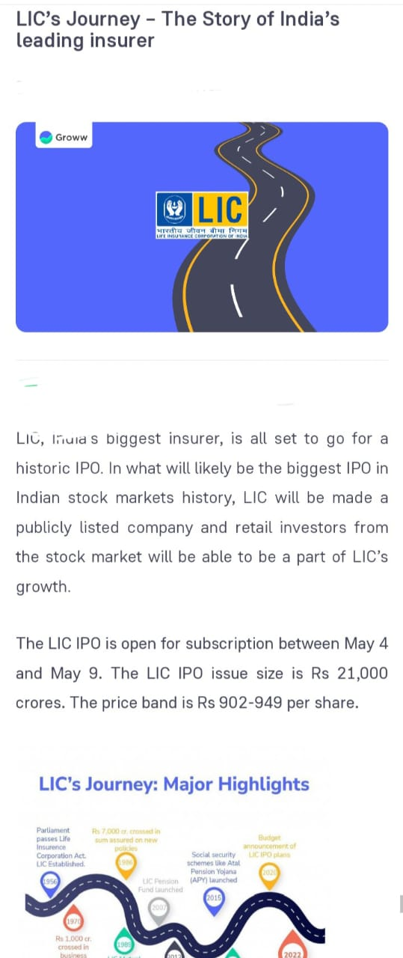
Format 2 : STORY
LIC, India’s biggest insurer, is all set to go for a historic IPO. In what will likely be the biggest IPO in Indian stock markets history, LIC will be made a publicly listed company and retail investors from the stock market will be able to be a part of LIC’s growth.
Caption along with CTA’s
In every unpredictable situation, we are always with you.
Contact us : licindia@gmail.com

Slide 23
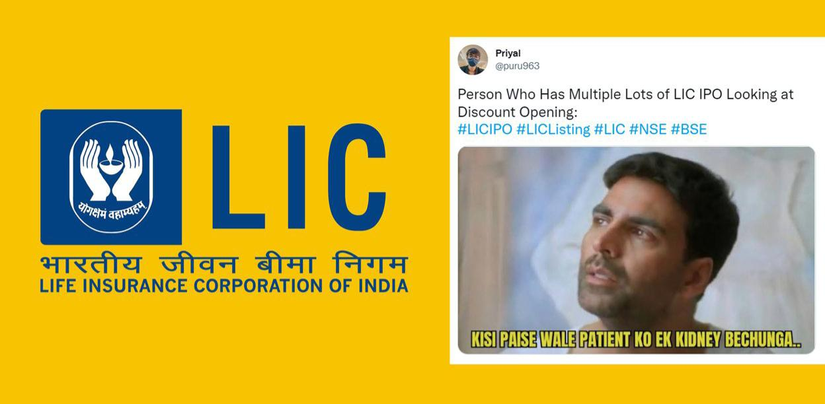
Format 3 : MEME
Person who has multiple lots of LIC IPO lookking at discounting opening
Caption along with CTA’s
Get the best insurance cover for your life..... LIC.
Contact us : licindia@gmail.com

Slide 24
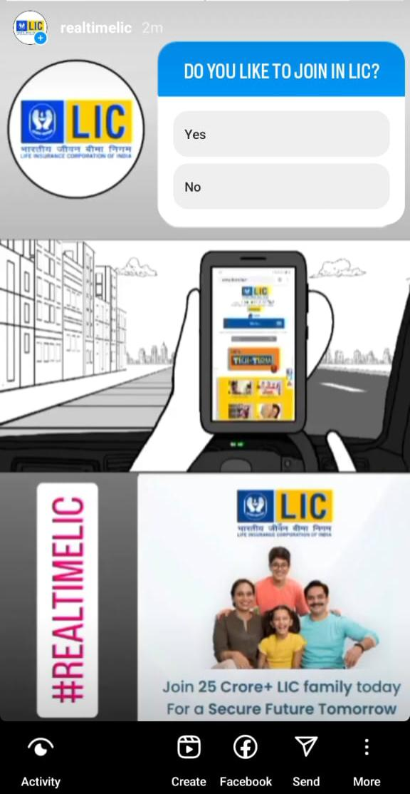
INSTAGRAM STORY
Instagram story link – 1
https://instagram.com/stories/realtimelic/3211938104063955272?utm_source=ig_story_item_share&igshid=MTc4MmM1YmI2Ng==
Instagram story Highlights -1
https://www.instagram.com/s/aGlnaGxpZ2h0OjE4MzE0NjEyODA5MTExNjY4?story_media_id=3211938104063955272_62486097738&igshid=MzRlODBiNWFlZA==

Slide 25
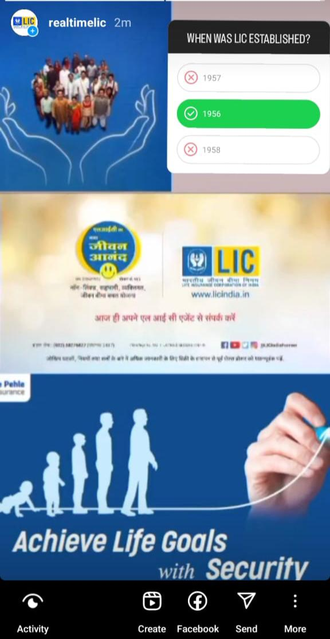
Instagram Story Link - 2
https://instagram.com/stories/realtimelic/3212346919649455684?utm_source=ig_story_item_share&igshid=MTc4MmM1YmI2Ng==
Instagram Highlight Link- 2
https://www.instagram.com/s/aGlnaGxpZ2h0OjE4MzE0NjEyODA5MTExNjY4?story_media_id=3212346919649455684_62486097738&igshid=MzRlODBiNWFlZA==

Slide 26
Designs/video editing
https://drive.google.com/file/d/1HH8ZxQaFApYlhv2RZx50rhK8N3mtnuX6/view?usp=drivesdk

Slide 27


